Slide 1

BTH645 - Multimedia Elements for User Interfaces
Shi, Yue (Sunny)
sunny.shi@senecacollege.ca
SENECA COLLEGE

Slide 2
Outline
Videos
Using digital video
How video works
Digital video file formats
2

Slide 3
Using Video
Video is an excellent tool for delivering multimedia.
Video places the highest performance demands on a computer and its memory and storage.
Digital video has replaced analog as the method of choice for making and delivering video for multimedia.

Slide 4
Using Video
Video is an excellent tool for delivering multimedia.
Video places the highest performance demands on a computer and its memory and storage.
Digital video has replaced analog as the method of choice for making and delivering video for multimedia.

Slide 5
Using Video
Video is also very hardware-intensive.
a) Full screen, uncompressed video uses many megabytes per second (Mbps) of bandwidth and storage space.
b) Consider carefully the delivery platform when producing video.

Slide 6
How Video Works
Light reflected from an object through the camera’s lens is converted into an electronic signal by a charge-coupled device (CCD).
This electronic signal contains three channels of color information and synchronization pulses (sync).
Most consumer-grade cameras have a single CCD
Professional-grade cameras have three (3) CCDs, one for each color of:
Red
Green
Blue

Slide 7
How Video Works
Several video standards exist that deal with the amount of separation between the components of the signal.
The more separation of the color information,
the higher the quality of the image,
and the more expensive equipment.

Slide 8
How Video Works
Analog video transfer methods
Component video separates color and brightness over three cables. (Best quality)
S-video separates color and brightness over two wires. (Medium quality)
Composite video transmits the whole video signal in a single cable. (worst quality)

Slide 9
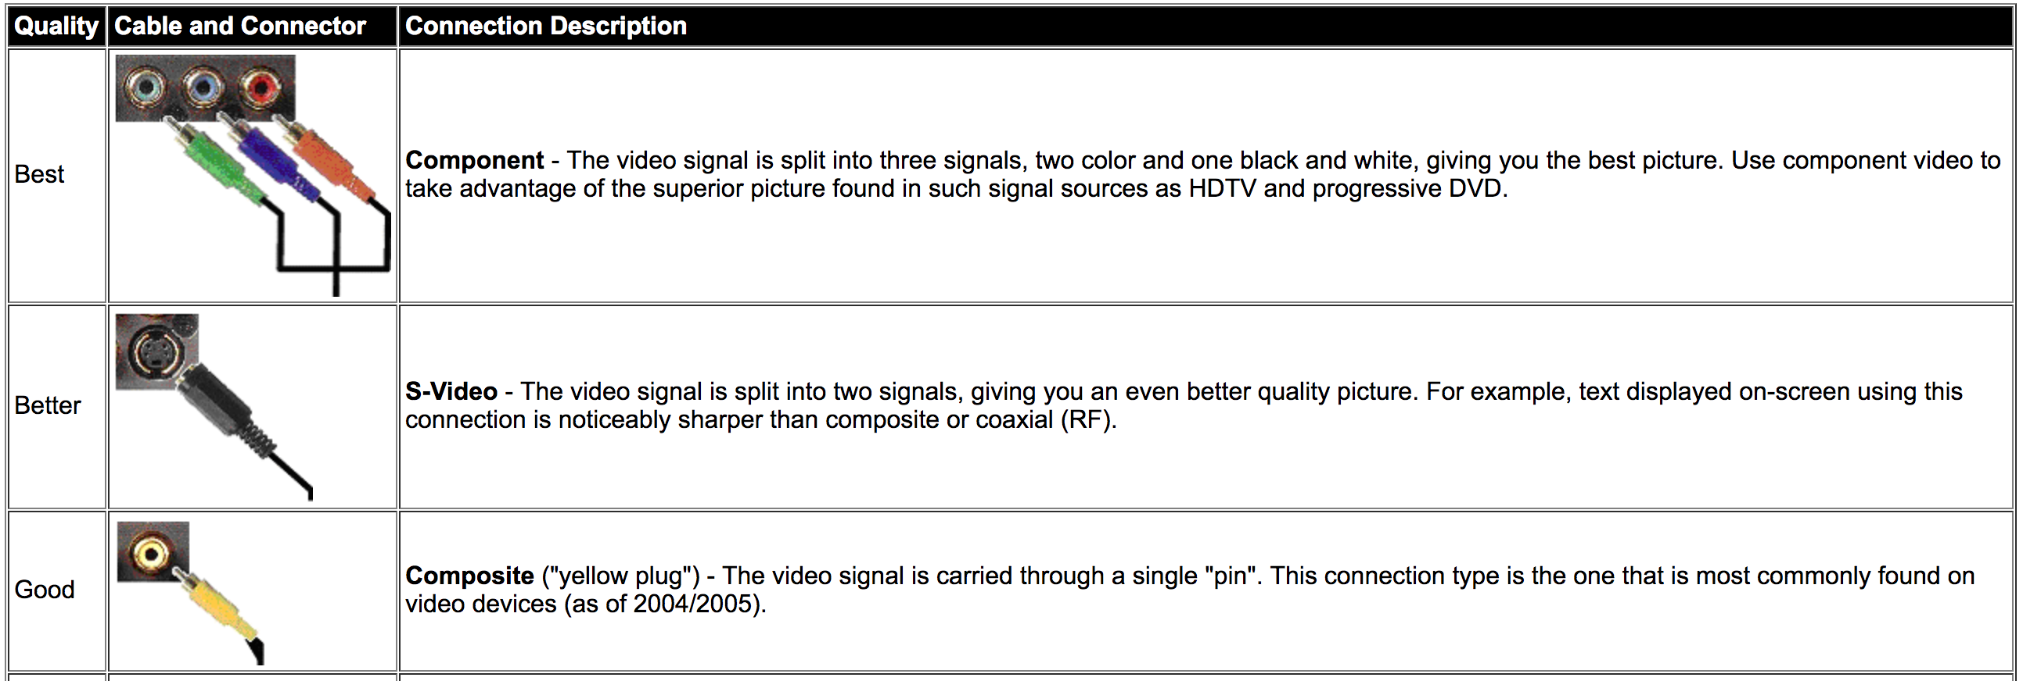
High-Definition Multimedia Interface (HDMI) is better.
HDMI is a digital cable and connector,
so there’s no wasted conversion from your digital Blu-ray disc,
as there is over an analogue component cable
Reference: http://www.lyberty.com/encyc/articles/svideo.html

Slide 10
How Video Works
Current TV sets provide:
composite signal connector,
S-Video connector
High-Definition Multimedia Interface (HDMI) connector for purely digital input
Video displays for Computers:
Analog component (red, green, blue) input through 15-pin VGA connector
A purely digital DVI (Digital Visual Interface)
HDMI connection

Slide 11
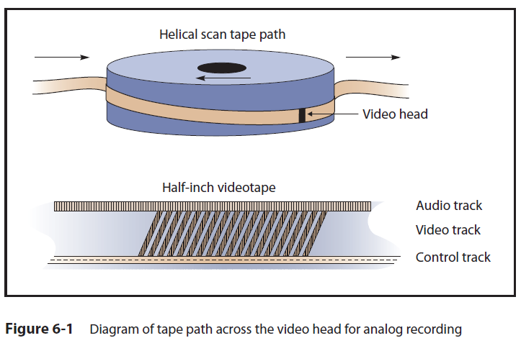
How Video Works
Analog video
Video is recorded onto magnetic tapes

Slide 12
How Video Works
Analog display standards
National Television Standards Committee (NTSC).
These standards define a method for encoding information into an electronic signal that creates a television picture.
screen resolution: 525 horizontal scan lines
scan rate: 30 frames per second (fps).
used in North America, South America, and Japan.

Slide 13
How Video Works
Analog display standards
2. Phase Alternate Line (PAL)
Screen resolution: 625 horizontal interlaced lines
scan rate: 25 frames per second (fps).
used in China, Australia, United Kingdom, Western Europe, South Africa, and South America.

Slide 14
How Video Works
Analog display standards
3. Sequential Color and Memory (SECAM).
screen resolution: 625 horizontal lines
Frame rate: frames per second 25 fps
used in France, Russia, and a few other countries.

Slide 15
How Video Works
Digital video signals consist of a discrete color and brightness (RGB) value for each pixel.
Digitizing analog video involves reading the analog signal and breaking it into separate data packets.
This resolution is limited to the number of horizontal scan lines.

Slide 16
How Video Works
Digital video
The output is digitized by the camera into a sequence of single frames.
The video and audio data are compressed before being written to a tape or digitally stored.

Slide 17
How Video Works
Digital video
HDTV: High Definition Television
Multiple HDTV formats exist.
Resolutions vary from 720 to 1080 lines.
Frame rates vary from 24 to 60 fps.
Formats can either be interlaced or progressively scanned.

Slide 18
How Video Works
Digital video
The aspect ratio of HDTV is 16:9.
The 16:9 aspect ratio is also sometimes called “widescreen.”
This aspect ratio allows the viewing of Cinemascope and Panavision movies.
The aspect ratio of NTSC, PAL, SECAM, and computer monitors is 4:3.

Slide 19
How Video Works
CRT and LCD displays
Interlacing and progressive scan technologies
Interlacing: the process of building a single frame from two fields, even and odd scan lines.
Draw even scan lines, then the odd scan lines.
Two of these even and odd scan line fields make up one video frame.
Video sources are listed with the letter i, such as 480i or 1080i.

Slide 20
How Video Works
CRT and LCD displays
Interlacing and progressive scan technologies
Progressive-scan: used by computer monitor, draw the lines of an entire frame (both the even and odd scan lines ) in a single pass, without interlacing them and without flicker.
Video sources are listed with p, such as 480p, 720p or 1080p.
The numbers listed before the p or the i represent the number of scan lines the video source uses to reproduce the video.

Slide 21
How Video Works
high-definition video, Interlacing, progressive, frame rate
https://www.youtube.com/watch?v=QojksfRs_5g
720p vs 1080i HD Explained
https://www.youtube.com/watch?v=Avvh0iH2xSg#t=18.727301

Slide 22
How Video Works
Resolution
The resolution of the monitor refers to the maximum amount of pixels that can be displayed on the screen.
HD is a common standard referred to by television manufacturers which now generally use 1080p, as resolution that is made up by a horizontal display of 1920 pixels and a vertical display of 1080 pixels.
The relationship between screen size and screen resolution is referred to as pixel density, measured in Pixels per Inch (PPI).
As the screen sizes become smaller and/or the number of pixels increase the visibility of individual pixels reduces resulting in a higher PPI.
Reference: https://www.iiyama-monitors.co.uk/faqs/resolution.aspx

Slide 23
How Video Works
Common monitor resolutions:
1920x1080 - 1080p (HD)
This is one of the most common resolutions used currently, it’s commonly found in televisions & is supported by the common connectivity type HDMI, a modern, digital cable type commonly found in most households now.
2560x1440 - 1440p (WQHD)
A ‘Wide Quad HD’ monitor is a great step up from 1080p. A screen with such a high resolution will make photos look incredible & will give you much more workspace on your desktop. The term Quad HD implies a resolution of four times that of standard HD or 1280x720.
4096x2160 - 4K (UHD)
4K is the next big step up, and is now available on quite a lot of televisions. As with TVs, a 4K computer monitor has a display resolution of 3840×2160. This is about four times as many pixels as a typical 1920×1080, or 1080p, display.
The broadcast industry promulgated an ultra-high-resolution, 1920 X 1080 interlaced format (1080i) to become the cornerstone of the new generation of high-end entertainment centers.
Mobile devices are making 640 × 480 popular again.
Reference: https://www.iiyama-monitors.co.uk/faqs/resolution.aspx

Slide 24
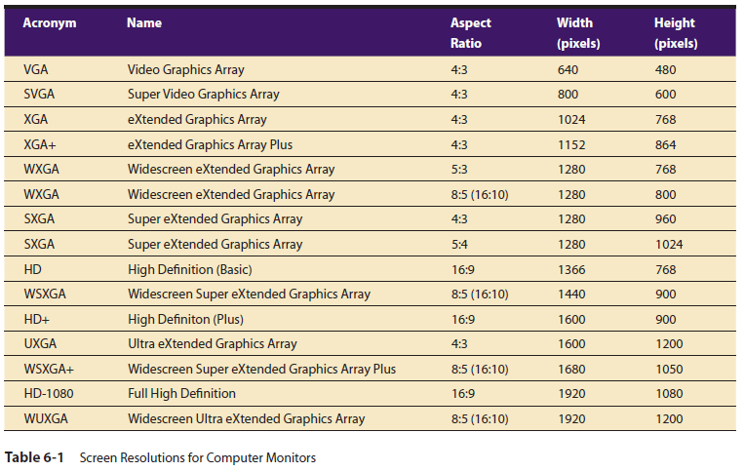

Slide 25
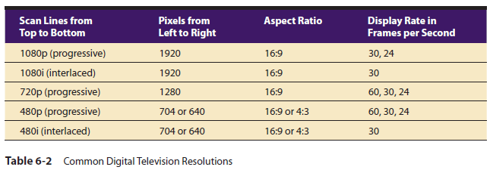
High Definition video quality:
1080p > 720p > 1080i > 480p > 480i
1080p: Cannot broadcast, (HD-DVD & blu ray can)
Current Best is 720p
Then 1080i

Slide 26
How Video Works
Overscan and safe title area
Every analog TV displays the picture differently.
Some of the picture is usually cut off at the edges.
This is called overscan.
Editing systems use action safe and title safe overlays to ensure that action and titles are not cut off by overscan.

Slide 27
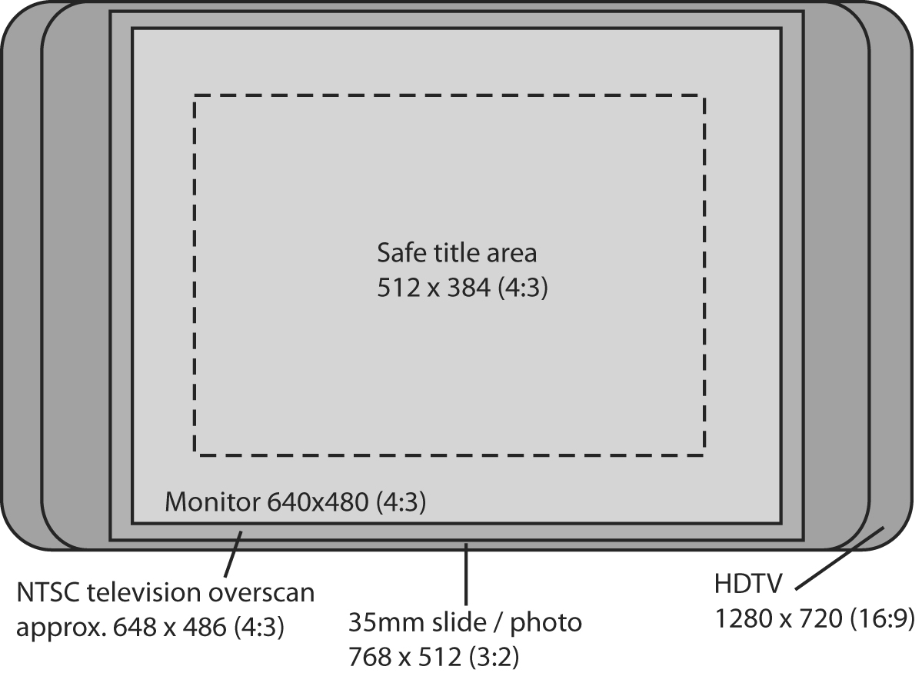
Difference between VGA and HDTV aspect ratios

Slide 28
Video Format
Involves two concepts:
Containers /formats (aka wrappers)
Codecs (short for coder/ decoder)
Codecs are used inside of a container

Slide 29
Digital Video Containers
Container describes the structure of the file:
Where the various pieces are stored
How they are interleaved
Which codecs are used by which pieces
It may specify an audio codec as well as video
It is used to package the video and its components (audio/ metadata)

Slide 30
Digital Video Containers
Container may include
data compressed by a choice of codecs, and
media players may recognize and play back
metadata – important information about the tracks contained in them
even additional media besides audio and video.

Slide 31
Digital Video Containers
Codecs - Short for coder/ decoder
The algorithm used to compress (code) a video for delivery.
Decodes the compressed video in real-time for fast playback.
The chief determiner of quality

Slide 32
Digital Video Containers
Codecs
Compression is necessary when working with video on computers.
Compression is performed by a compression/decompression scheme called a codec.

Slide 33
Container And Codec
Think of the container as the file itself
Think of the codec as its contents
Most good container formats can hold many codecs
The quality or features of the video is determined by the codec, NOT the container.
Proper way to describe video is to indicate both:
A .MOV file containing H.264 data
An .AVI file containing DivX data
Or, “Give me an H.264 Quicktime file (.mov)”

Slide 34
Choose Codec
Depending on the transmission of the media
External hard drive, flash disk, email, upload online
Public online: check the requirements from the websites (e.g., supports a MP4 container, H.264 codec)
Mobile app: select a codec supporting all mobile devices (e.g., Apple does not support flash videos)
Embedded in another app: check the app
Apps will take the video and apply their own codec to the video

Slide 35
Common Containers
AVI (Audio Video Interleave): window’s standard multimedia container
MPEG-4 part 14 (aka .mp4): standardized container for MPEG-4
MOV: Apple’s QuickTime container format
OGG, OGM & OGV: open-standard containers
ASF: Microsoft format designed for WMV and WMA. Files end in .wmv or .asf
VOB (DVD video Object): DVD’s standard container
WebM: royalty free, open video compression for use with HTML5 video.
FLV (Flash Video): the format used to deliver MPEG video through Flash Player

Slide 36
Common Codecs
MPEG (Moving Pictures Expert Group): three video formats, MPEG1, 2, 4
MPEG-1: old, supported by everything, 352X240, reasonably efficient, good format for the web
MPEG-2: better compression than MPEG-1, 720X480, used in HDTV, DVD, SVCD
MPEG-4: a family of codecs, some of which are open, others Microsoft proprietary.
H.264: Most commonly used codecs for videos uploaded to the web. Part of the MPEG-4 codec.

Slide 37
Common Codecs
.MJPEG (Motion JPEG): a codec consisting of a stream of JPG images.
Common in video from digital cameras, and a reasonable format for editing videos.
Does not compress well, so not good for web distribution
DV (Digital Video): usually used for video grabbed via firewire off a video camera
Fixed at 720X480 @29.97FPS, or 720X576 @ 25FPS
Not very highly compressed

Slide 38
Common Codecs
WMV (Windows Media Video): a collection of Microsoft proprietary video codecs. Since Version 7, it has used a special version of MPEG4
RM (Real Media): a closed codec developed by Real Networks for streaming video and audio
DivX: can compress lengthy video segments into small sizes while maintaining relatively high visual quality
in early versions, essentially an ASF codec inside an AVI container
DivX 4 and later are a more full MPEG-4 codec
No resolution limit
Requires more horsepower to play than MPEG-1, less than MPEG-2
Hard to find Mac and Window players

Slide 39
Common Codecs
Quicktime 6: Apple’s implementation of an MPEG-4 codec
RP9: very efficient streaming proprietary codec from Real (not MPEG4)
WMV9: proprietary, non-MPEG4 codec from Microsoft
Ogg Theora: relatively new open format from Xiph.org
Dirac: very new open format under development by the BBC

Slide 40
File Size & Quality
Digital Storage Space – uncompressed digital video has a data rate of approximately 30 Mbps.
Frames per Second (FPS) – standard: 29.97.
higher FPS → smoother image
Video Bitrate- measurement of the number of bits that are transmitted over a set length of time.
Overall bitrate is a combination of the video stream, audio stream & metadata in the file
Majority coming from video stream.

Slide 41
File Size & Quality
Resolution – the number of pixels present in the images of the video.
Higher resolution →clearer image & bigger file

Slide 42
Summary
A digital video method is used for making and delivering video for multimedia.
A charge-coupled device (CCD) converts the light that has been reflected from an object through the camera’s lens.
Two scanning methods for video display: interlaced or progressive scan.
Codecs are used to compress (code) a video for delivery and decompress a video for playback.

Slide 43
Next Class
Test on Monday March 4, 2019

Slide 44
Thank you!

